Slide 1
New Era of ai artificial intelligence Smart HOME AUTOMATION
New Era (N. ERA) focuses on artificial intelligence and robotic development, with core competencies include in-house development, production, application deployment, and global-scale operation. We offer cutting edge integrated service robots .

Slide 2
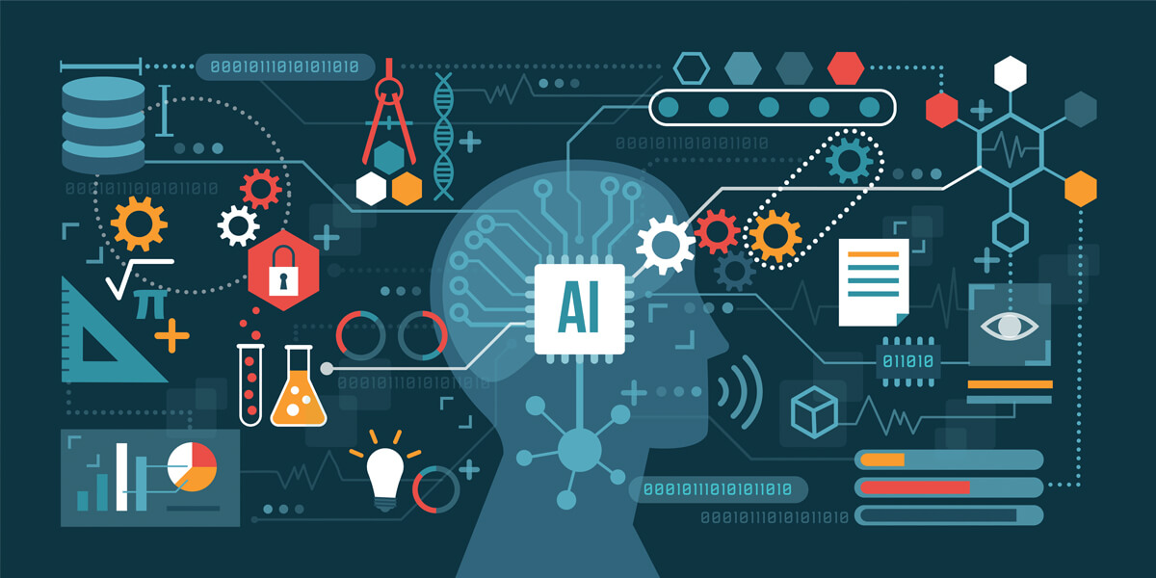
Click to WE NEED TO CREATE A POSITIVE UTOPIA FOR THE UPCOMING AGE OF ARTIFICIAL INTELLIGENCE.
Artificial intelligence (AI), also becoming a powerful presence in technology, has been swiftly dominating the home automation market. AI allows us to integrate smart solutions into our everyday tasks. Not only is AI creating solutions to common everyday problems, but it also making life simpler for everyone. Its presence in home automation allows us to control our appliances, secure our homes, and even limit our expenses. The ultimate goal of home automation is to limit the need for human involvement. With AI, this goal is well within reach.

Slide 3
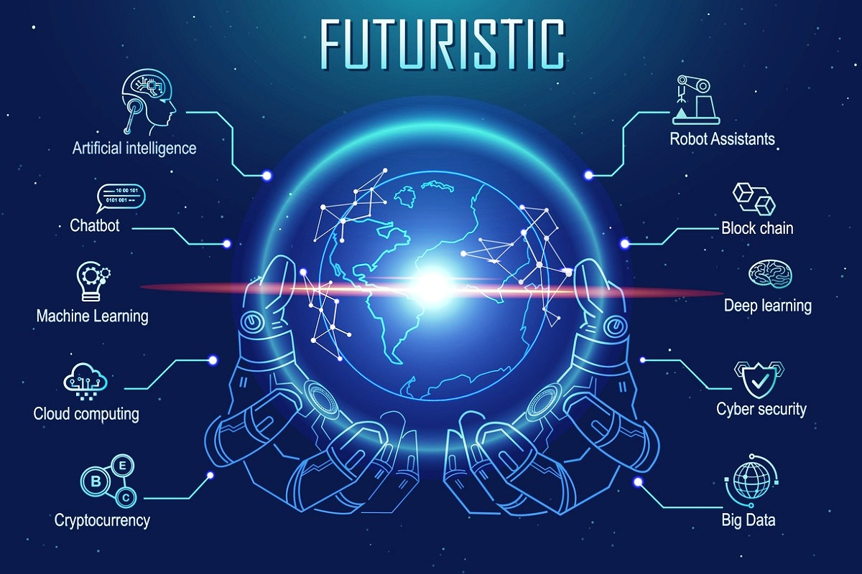
Artificial intelligence, although only a relatively new idea, is accessible today by anyone who has access to a computer or a smart phone. Artificial intelligence as a term was only created in 1956, when modern computing as a field was still in its infancy. Today, large tech companies such as Apple, Google, and Amazon allow mostly free access to their smart assistants or AIs. Siri, Google Assistant, and Alexa are all readily available to help us busy humans.
These modern AIs are powerful but still many decades away from true superintelligence when AIs become smarter than humans. AIs are created to help humans solve problems, whether it be creating schedules, finding songs on being played on the radio, or being available to answer nearly any question. But AIs can do much, much more than what most people use them for today.

Slide 4
Home automation
Not only does AI offer simplicity, but it also offers safety through home automation. Home security, once only available to the rich, is becoming cheaper and more accessible.
With home automation, home security is becoming smarter. Linked IoT camera systems can be connected to a home AI, alerting the user of any changes in or around the home or any suspicious activity. Camera systems can also be accessed from a phone or computer if the AI detects something out of place. Typical home security systems require a lot of user input. When leaving a home, a security system must be activated or deactivated from a local access point.
With home automation through AI, this is no longer the case. Security systems can be activated or deactivated with a simple voice command. This allows remote access to a home’s security system by use of a cell phone or a computer.

Slide 5
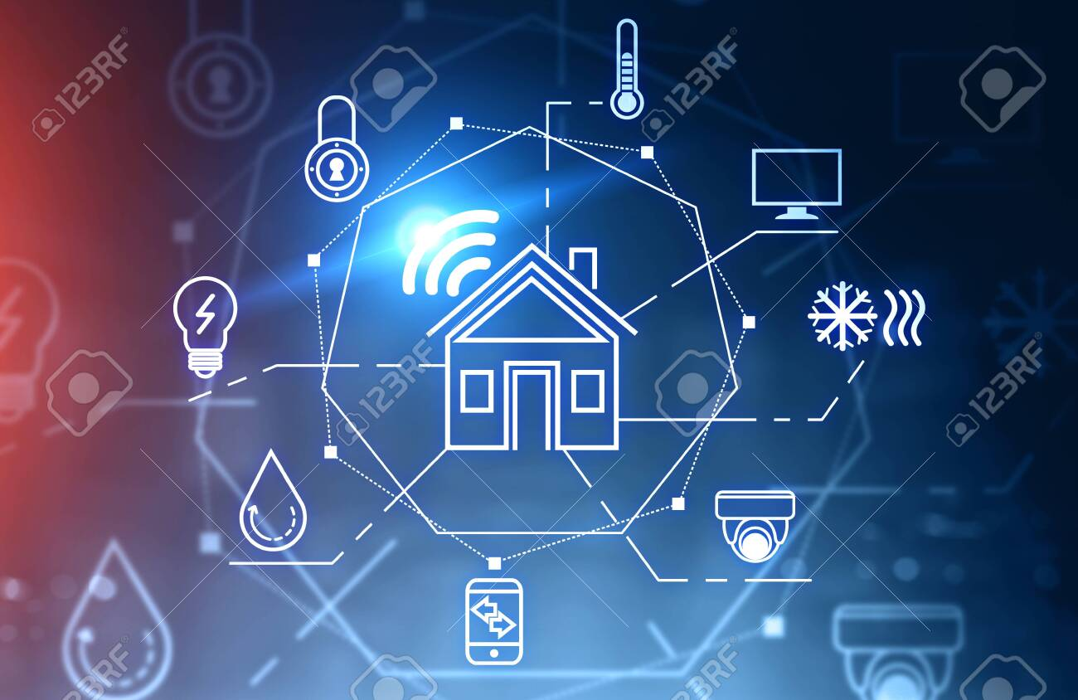
The future of smart homes
Home automation is changing the way people think about their daily tasks. AI is currently becoming so powerful that the tasks of yesterday are no longer a concern of today or tomorrow.
The reason why AI is so powerful is that it can think problems through. AI can learn and adapt to changing environments. They are programmed to complete tasks for us and get smarter by continuously evaluating their own performance. Simplicity, access, and affordability are some of the most important factors in creating smart homes.
As technology advances and access increases, smart homes will be a very common sight in the future. Whether it be home security, smart lighting, or temperature control, Artificial intelligence is making home life simpler. Mundane tasks that took time out of people’s lives will become completely automated and painless. By doing so, Artificial Intelligence is making the goal of home automation — limiting human involvement — a reality. Beyond this, future possibilities are endless.

